Slide 1
Module 6:Customizing SharePoint Pages

Slide 2
Module 6
Customizing SharePoint Pages
Distinguishing between wiki pages and web part pages
Create and edit site pages with metadata
Format wiki pages
Publish page layouts
Tailor pages for different users
Build page functionality into your site with SharePoint apps
Roll up content across your sites using the Content Query Web Part
Roll up information across your enterprise with the Content Search Web Part

Slide 3
Pages
Classic Pages (SitePages Lib)
Wiki Page
Web Part Pages
Publishing Pages (Pages Lib)
Page
Article Page
Welcome Page
Error Page
Modern Pages (SitePages Lib)
Site Page
Notes:
SharePoint Designer 2013 is the tool of choice for the rapid development of SharePoint applications. Please make sure your installation of SharePoint Designer is up to date by using Microsoft Update, or installing Service Pack 1

Slide 4
Page Layouts for Publishing Pages
Article Page
Catalog Item reuse
Enterprise wiki page
Error Page
Project Page
Redirect Page
Welcome Page
Custom Page Layouts

Slide 5
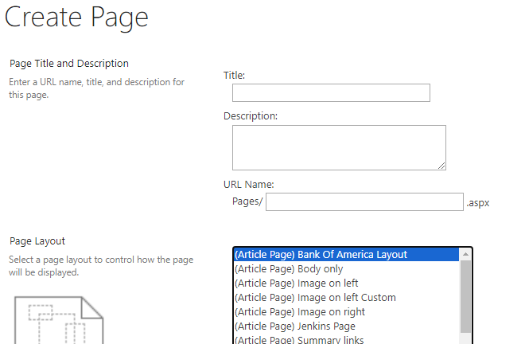
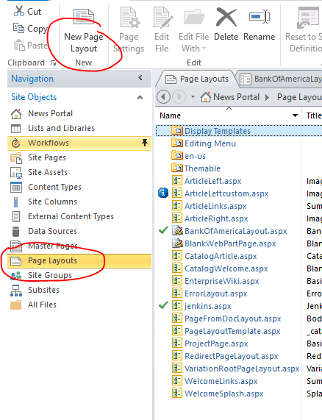
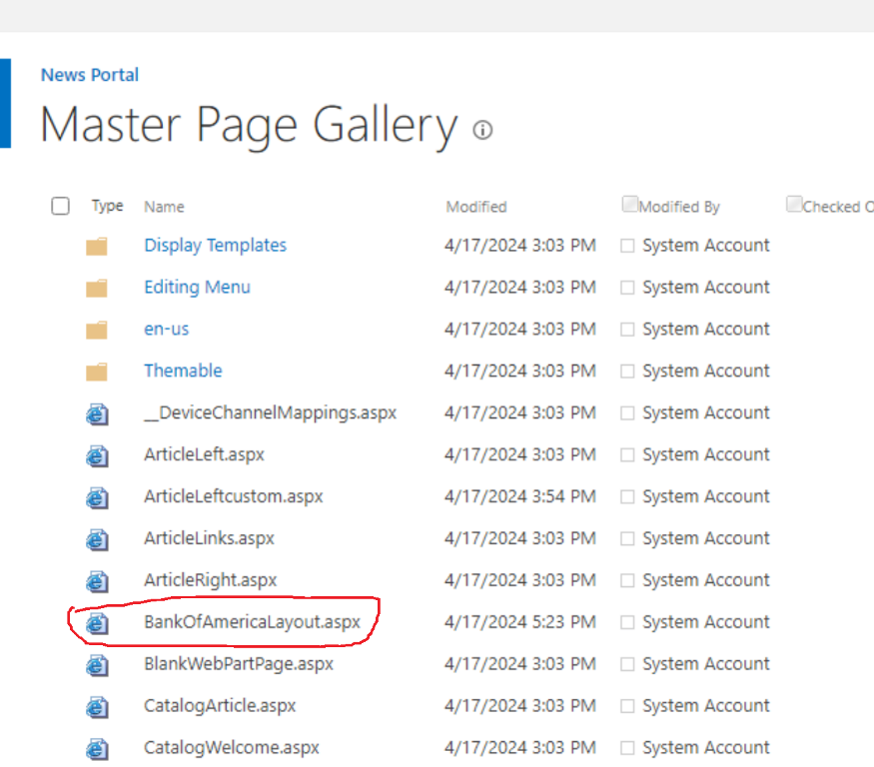
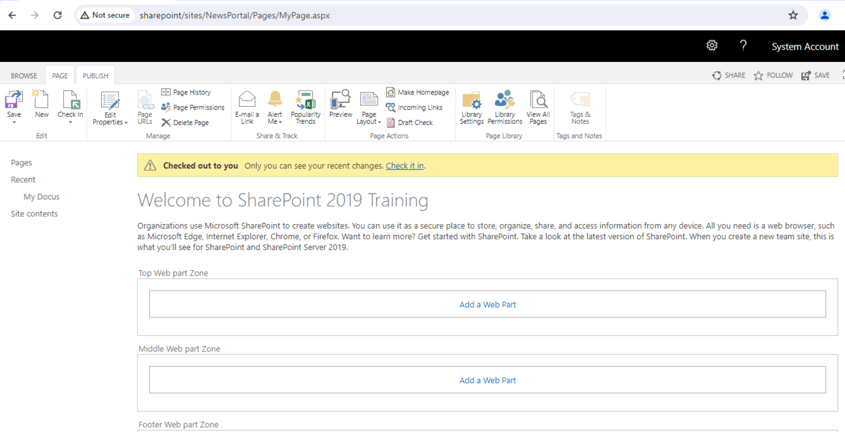
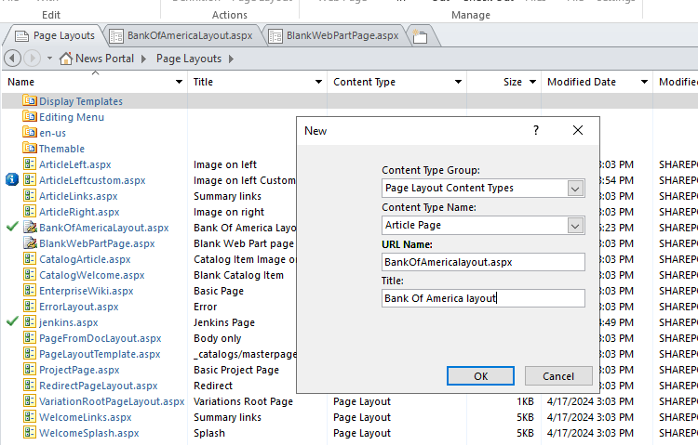
Custom Page Layout
Create Custom Page Layout for Publishing Portal

